Slide 1
3GPP TR 26.926 · NETWORK SIMULATION
XR & Cloud Gaming Traffic Modeling in ns-3
Simulator setup and empirical verification of statistical distributions

Slide 2


5G SPECIFICATION
The 3GPP TR 26.926 Framework
Immersive Services: Latency-critical high-resolution interactive video streams.

Slide 3
VIDEO CADENCE
Strict Transmission Periodicity
16.6 ms
Continuous Rate: Constant inter-frame interval dictated by a 60 fps display.

Slide 4
APPLICATION LOAD
Video Frame Size Modeling
25 KB
Truncated Gaussian: Statistical model reflecting visual variations in dynamic gaming.
Mean frame size (Standard deviation: 5 KB)

Slide 5
SYSTEM DEPLOYMENT
Linux Build & Dependencies
01
02
03
Source Extraction
Dependency Resolution
Validated Build
Official ns-3.48 tarball archive.
CMake and Ninja installation.
Clean build via ./ns3.
Toolchain Validation: Resolved system dependencies prior to running the model.

Slide 6
SIMULATED TOPOLOGY
Point-to-Point Architecture
Sender Node
Receiver Node
IP Address: 10.1.1.1
IP Address: 10.1.1.2
Cloud Gaming Render Server
UDP Packet Sink Client
Controlled Channel: Point-to-point link configured at 100 Mbit/s with 2 ms delay.

Slide 7
TRANSPORT LAYER
Standard MTU Segmentation
1500 B
Network Packetization: Large video frames segmented into standard MTU Ethernet datagrams.

Slide 8
BURST BEHAVIOR
Intra-Burst Inter-Arrival Time
0.2 ms
Clustered Dispatch: Rapid succession of packet fragments composing the same video frame.

Slide 9

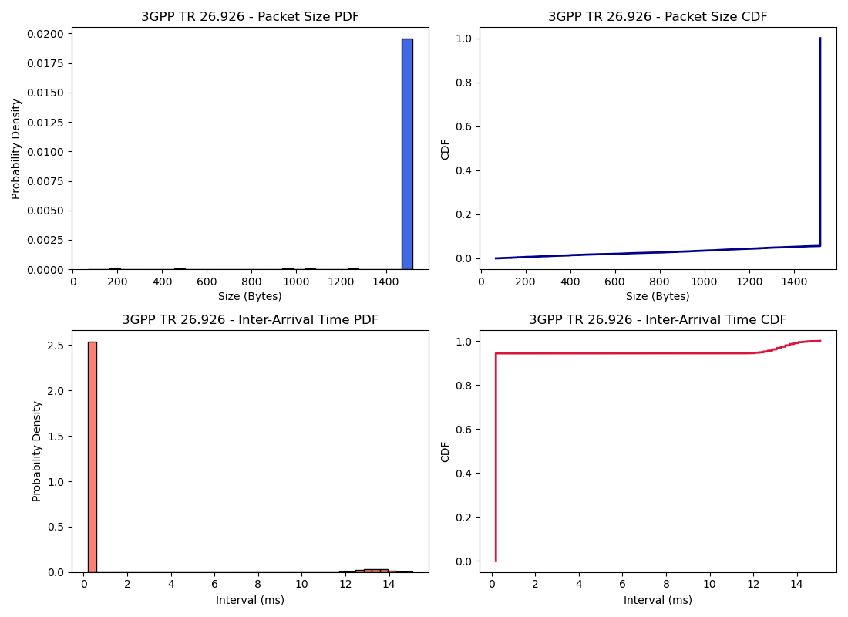
EMPIRICAL VALIDATION
Observed Statistical Distributions
Statistical Consistency: Validated probability densities matching cumulative distribution curves.

Slide 10
DISTRIBUTION ANALYSIS
Packet Size Distribution
> 94%
< 6%
Full MTU Datagrams
Residual Frame Fragments
Saturated packets at ~1500 bytes.
Remaining tail packet per video frame.
Standardized Profiling: Dominant spike at 1500 B confirming compliant segmentation.

Slide 11
TEMPORAL DYNAMICS
Bimodal IAT Distribution
0.2 ms
12–15 ms
Intra-Burst Arrival
Inter-Frame Idle
94% of observed intervals.
Idle window between consecutive frames.
Bimodal Signature: Signature fingerprint of bursty periodic video streaming.

Slide 12
SUMMARY & CONCLUSION
3GPP TR 26.926 Model Validated in ns-3
Model Verification: Accurate alignment between 3GPP specifications and simulation results.

